Slide 1

Detection and Classification of Fruit Diseases
Date: 29 May 2021
Medaramatla Gayatri - 17WH1A0540
Usakoila Mounika - 17WH1A0550
Sama Nischala - 18WH5A0506
Internal Guide : Ms. A Kranthi
Designation : Assistant Professor
Department of Computer Science & Engineering
BVRIT HYDERABAD College of Engineering for Women

Slide 2
PROJECT INTRODUCTION
Problem Statement:
This project aims at detection of fruit diseases at early stage since it will affect the agriculture field. The Disease is a major problem arising in an agriculture field. In plants most of the leaves and fruits are affected by diseases due to bacteria and virus.
The fruit details and the identification of diseases from the feature extraction are stored in the database. The classification and segmentation of fruit images were performed using K-Means Algorithm and SVM technique. The various features of few fruits were initially extracted and segment the respective images. After comparison the various diseases are analyzed and the optimal disease for the image is identified and the disease name is displayed.
BVRIT HYDERABAD College of Engineering for Women

Slide 3
DATASET
Dataset Description:
A public dataset from Kaggle and Mendeley on the Fruit Disease Detection Challenge is taken. The total size of the dataset is 5Gb.
The dataset has the images of fruits with the features of
blackspot.
Canker
Greening
Healthy
Scab
The dataset contains approximately 2000 images
For prediction apply the K-Means Algorithm and SVM models on the dataset by splitting the datasets in to 70 to 80% of training with these models and 30 to 20% of testing for predicting
BVRIT HYDERABAD College of Engineering for Women

Slide 4
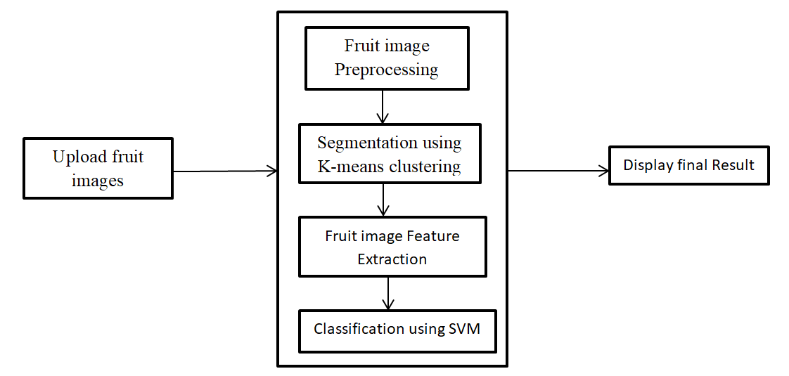
ARCHITECTURE
BVRIT HYDERABAD College of Engineering for Women

Slide 5
TECHNOLOGY STACK
Machine Learning
Tkinter
Python Programming Language
Required Python Packages:
NumPy
pandas
keras
sklearn
tkinter
matplotlib
7. TensorFlow
OpenCV-python
BVRIT HYDERABAD College of Engineering for Women

Slide 6
SYSTEM SPECIFICATIONS
ENVIRONMENT | SPECIFICATIONS
HARDWARE | Processor – i5 Processor Memory(RAM) - 4 GB and more
SOFTWARE | Python3 OS - Windows 10 Pycharm
BVRIT HYDERABAD College of Engineering for Women

Slide 7
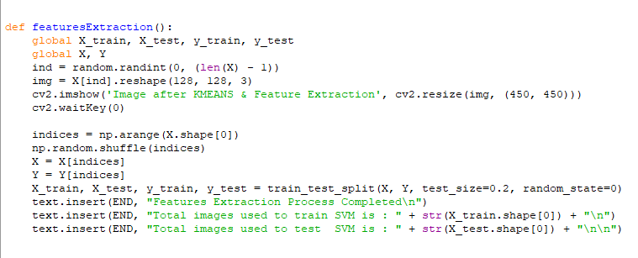
FEATURES EXTRACTION
BVRIT HYDERABAD College of Engineering for Women

Slide 8
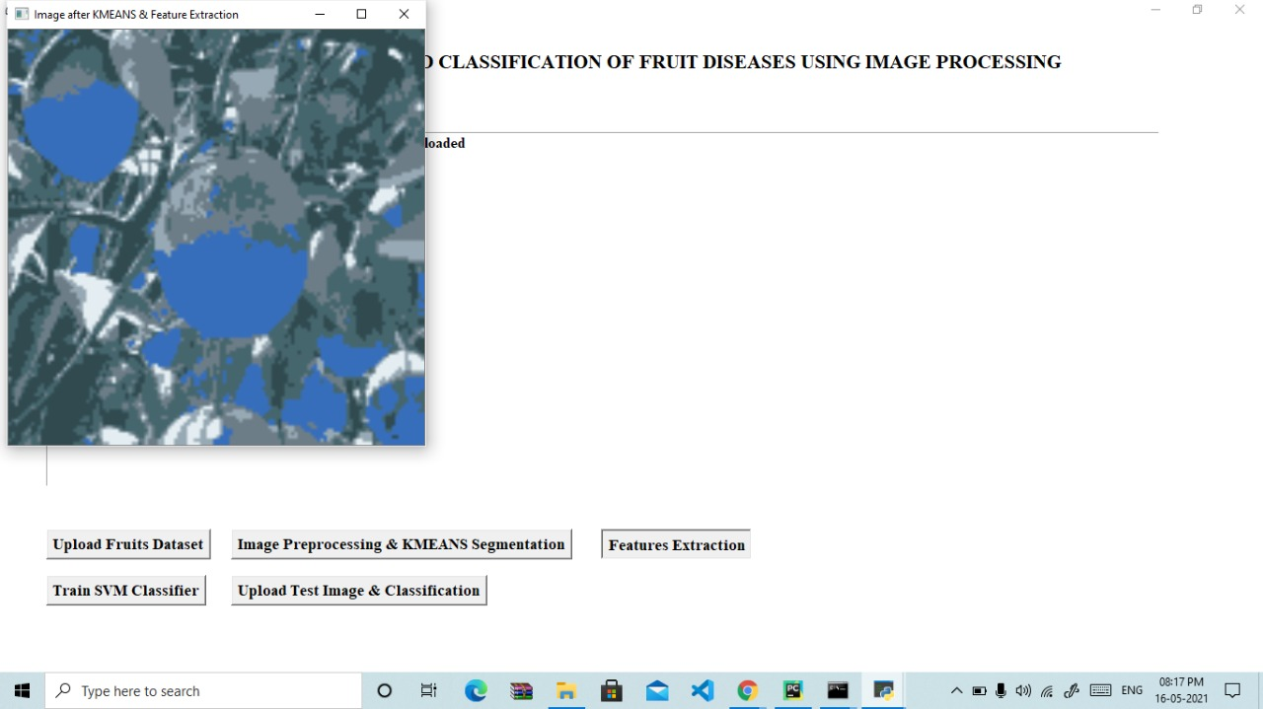
FEATURE EXTRACTION
BVRIT HYDERABAD College of Engineering for Women

Slide 9
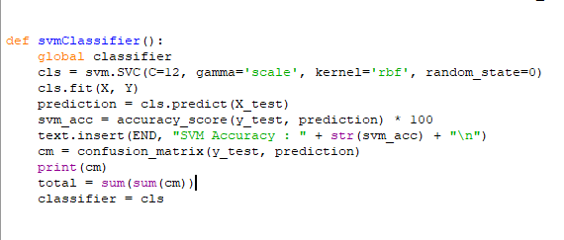

SVM CLASSIFIER
Confusion Matrix:
BVRIT HYDERABAD College of Engineering for Women

Slide 10
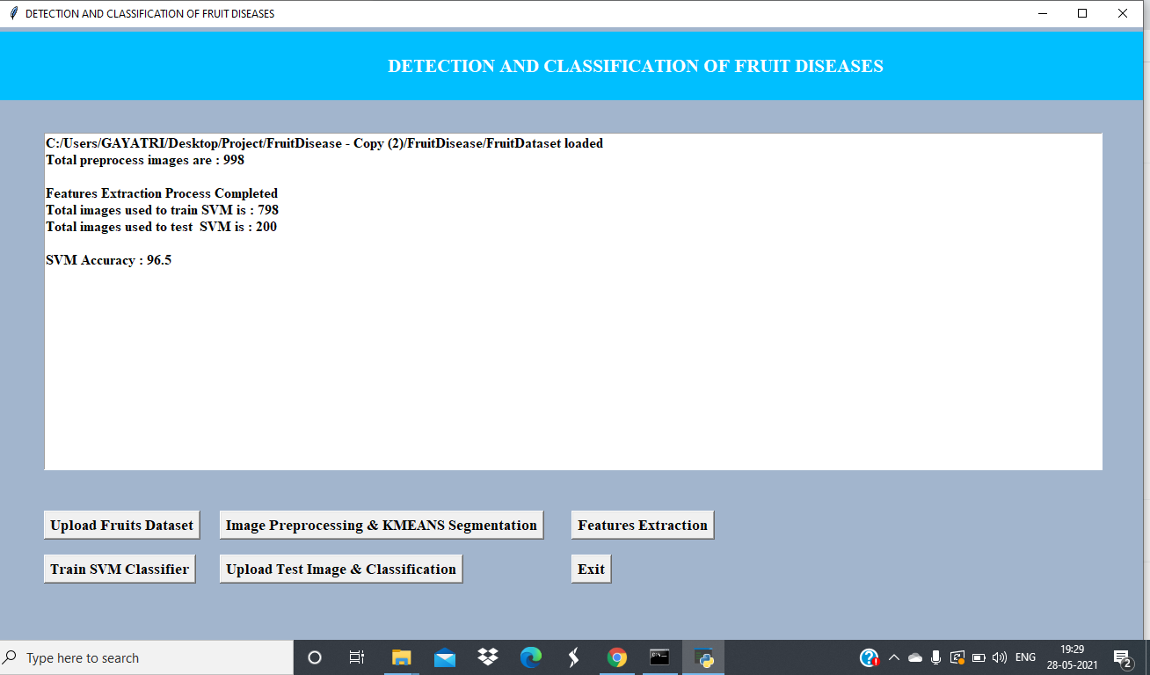
SVM CLASSIFIER
BVRIT HYDERABAD College of Engineering for Women

Slide 11
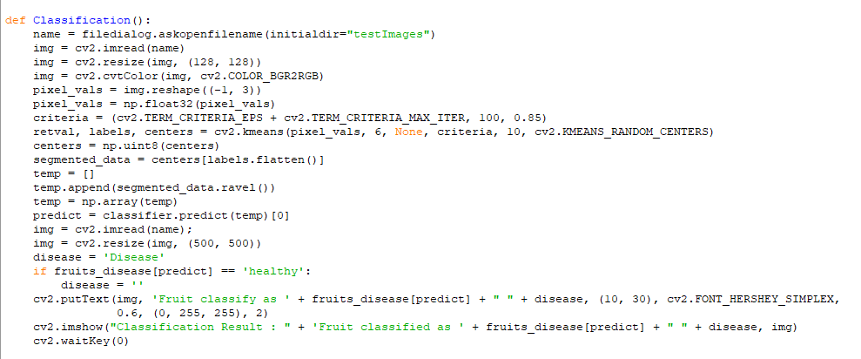
CLASSIFICATION
BVRIT HYDERABAD College of Engineering for Women

Slide 12
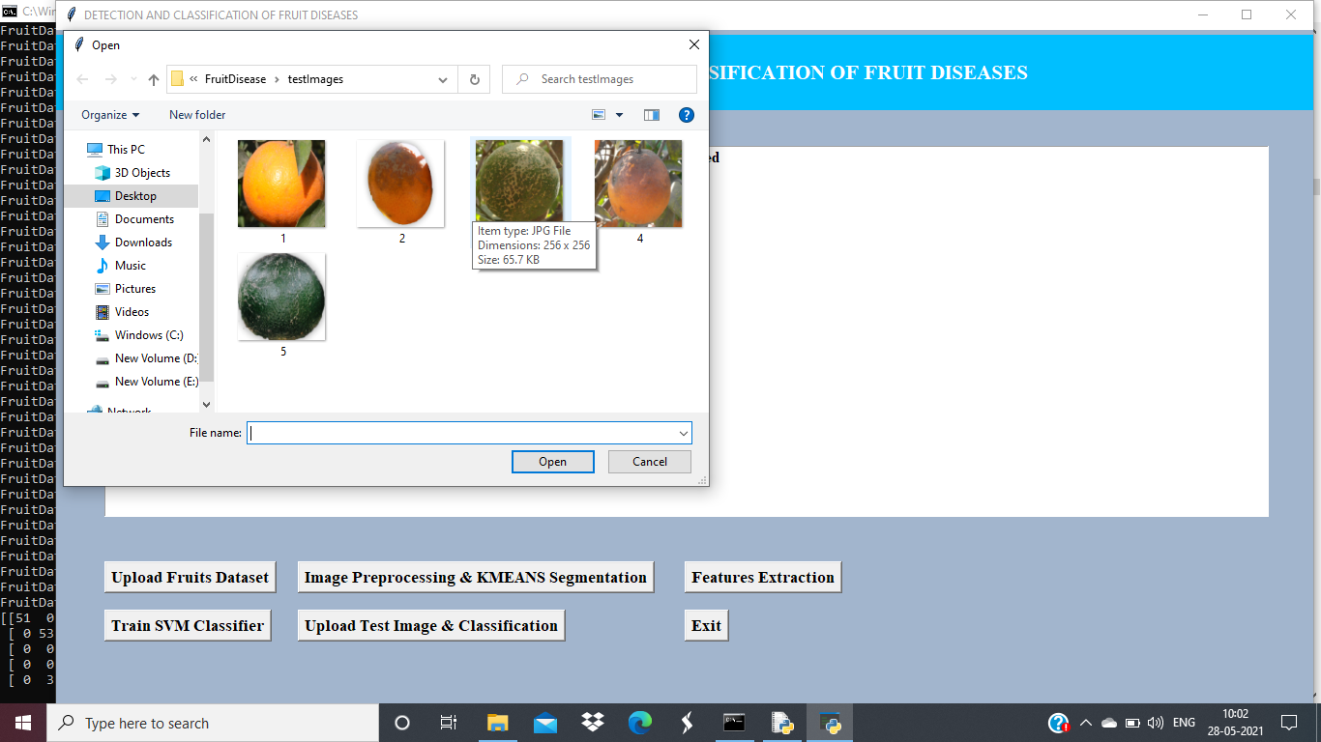
TEST IMAGES
BVRIT HYDERABAD College of Engineering for Women

Slide 13
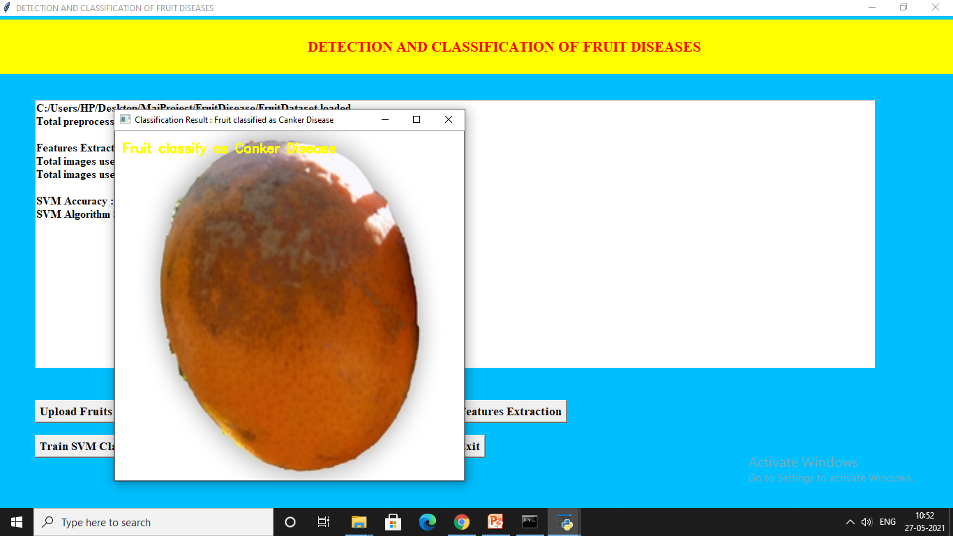
FINAL OUTPUT
BVRIT HYDERABAD College of Engineering for Women

Slide 14
References
Base paper:
https://ieeexplore.ieee.org/document/9104139
References:
https://www.irjet.net/archives/V4/i12/IRJET-V4I12213.pdf
https://www.kaggle.com/mcbean/fruit-classification-w-nn
https://data.mendeley.com/datasets/3f83gxmv57/2
BVRIT HYDERABAD College of Engineering for Women

Slide 15
Thankyou
BVRIT HYDERABAD College of Engineering for Women

